Slide 1
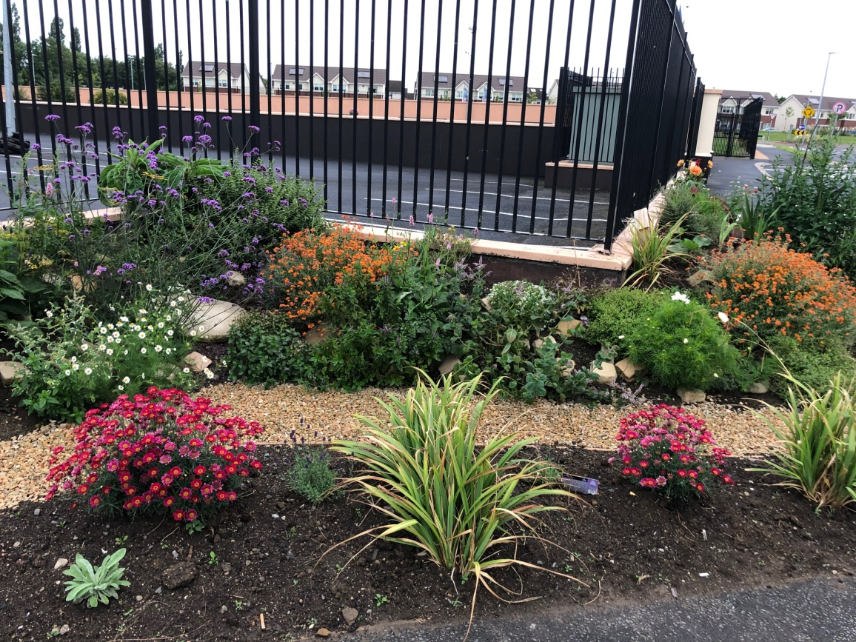
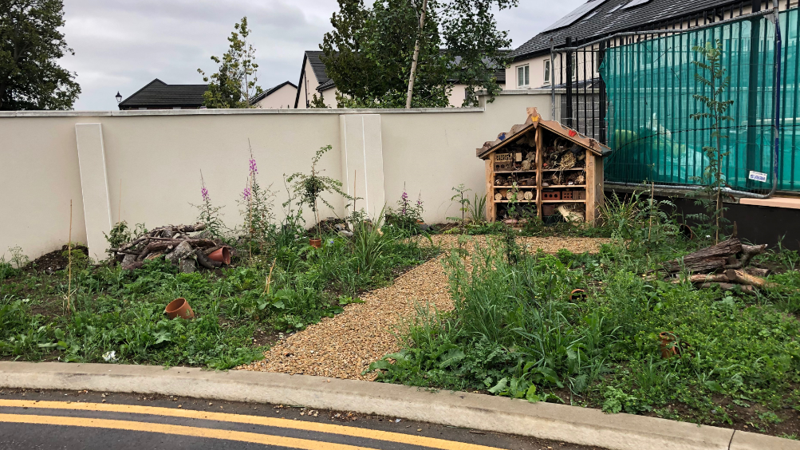
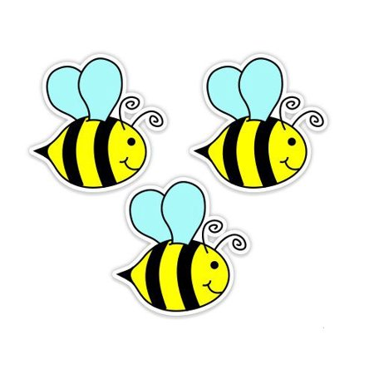
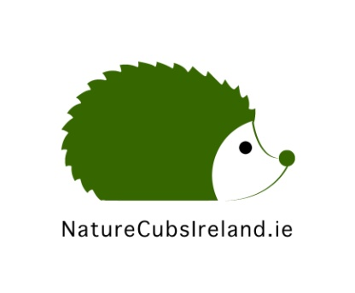
Our School Garden Journey!
September, 2019

Slide 2
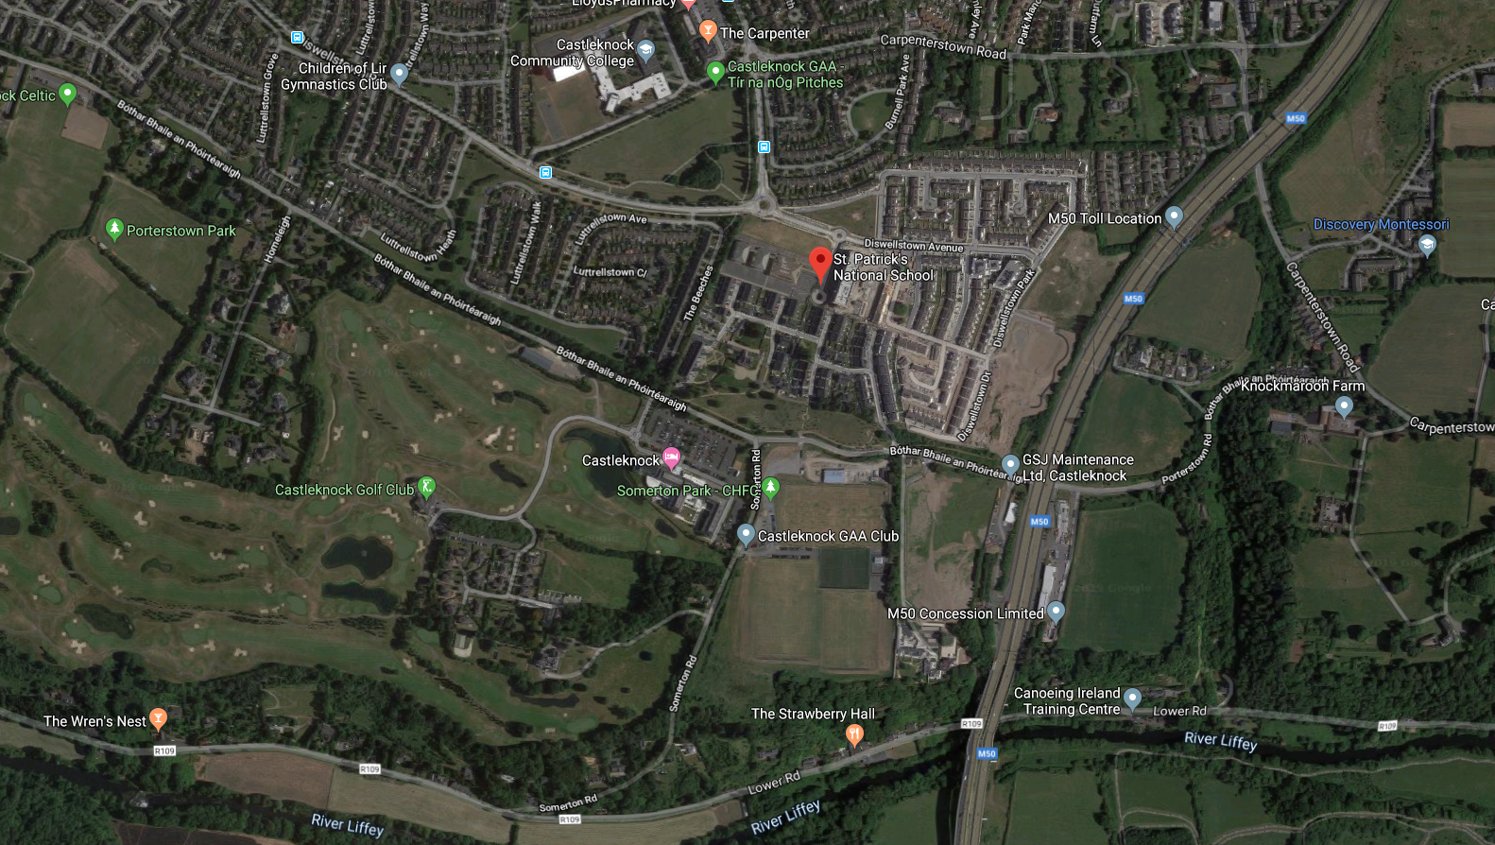
St. Patrick’s N.S. 2019. Surrounded by houses and roads. Not much habitat available.
Notes:
Note proximity to River Liffey and trees but very disconnected from such habitats. Now surrounded by housing estates. Wildlife have very little around the school to use as habitats.

Slide 3
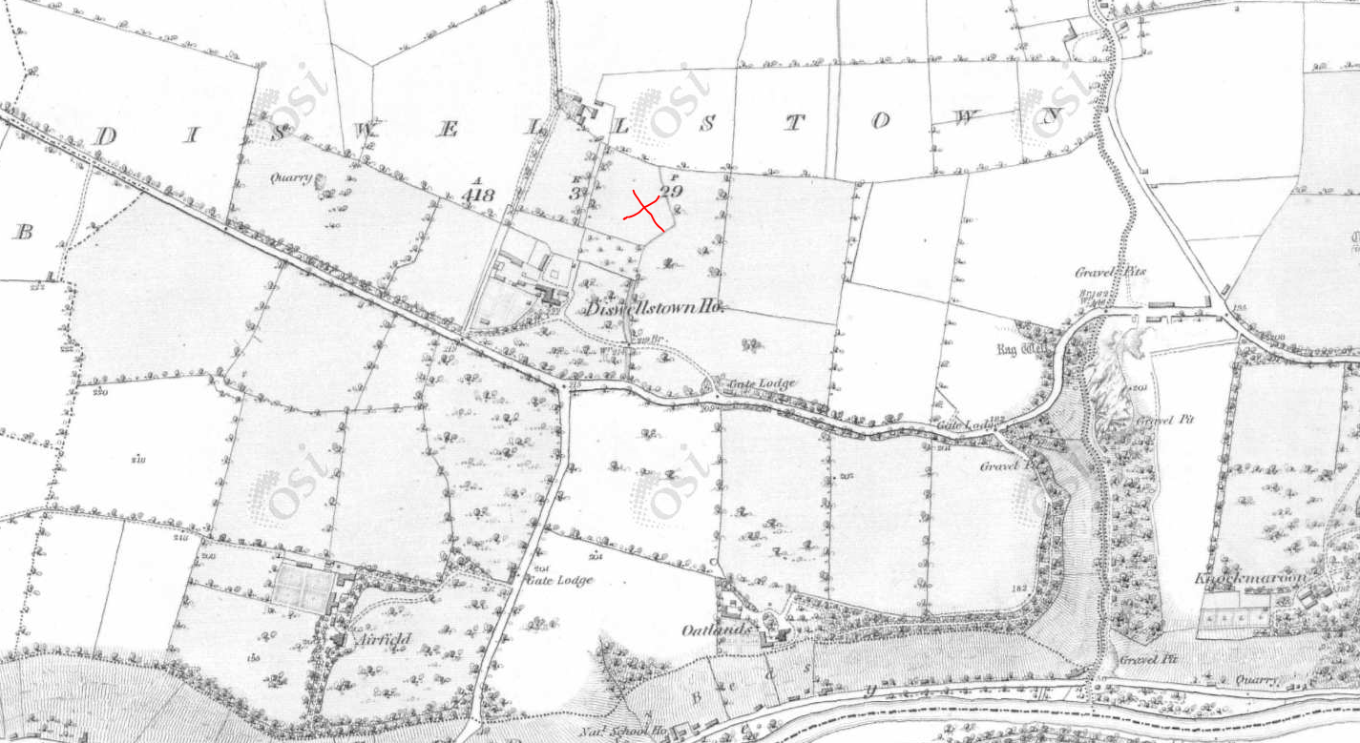
1829-1841. Countryside all around. Better for wildlife.
X is St. Patrick’s N.S. now.
Notes:
Note field boundaries. Locality was pastureland and agricultural with areas of trees around Diswellstown House. Space for wildlife.

Slide 4
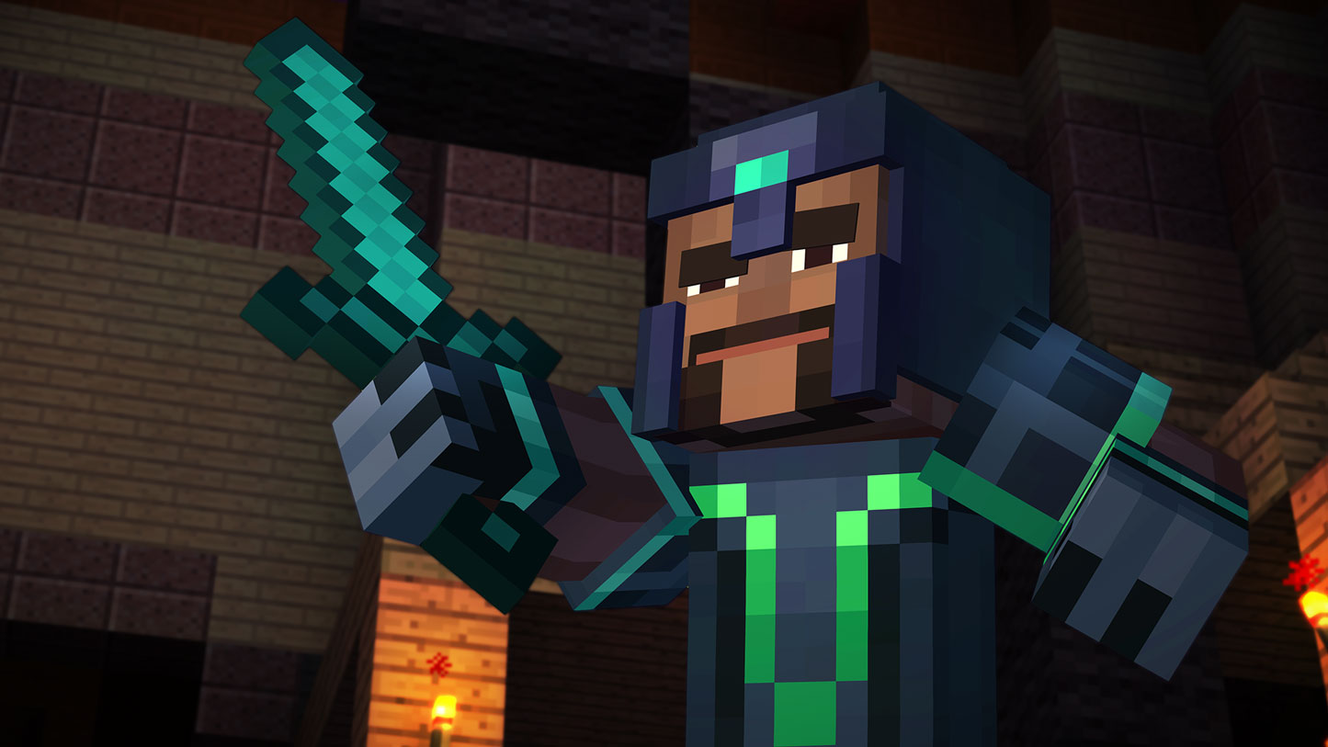
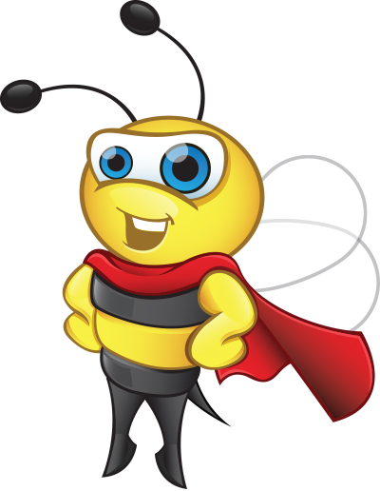
St. Patrick’s N.S. is taking action!
Notes:
Less habitats now in 2019 for wildlife so St. Patrick’s N.S. is trying to do its bit to conserve biodiversity.
How? Provide wildlife garden with pollinator friendly plants, logpiles, trees, rocks all for insects, frogs, birds, lizards and the greater food chain.

Slide 5
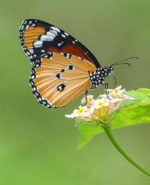
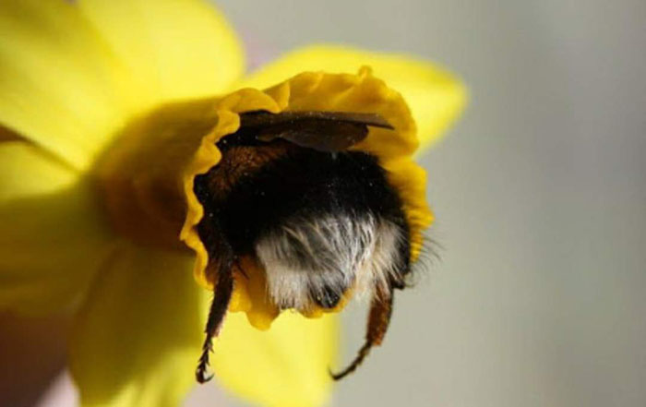
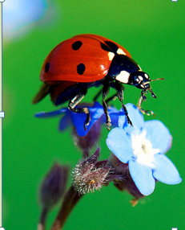
Pollinators!
By protecting pollinators, we’re protecting a vital part to the web of life and helping secure our food resources.
Notes:
By protecting pollinators, we’re protecting a vital part to the web of life.
Many kinds of animal pollinators: butterflies, bees, hoverflies, small mammals like mice, ladybirds.....
Middle bottom is bat pollinator in south america. Bats in Ireland catch insects in flight so don’t pollinate flowers.

Slide 6
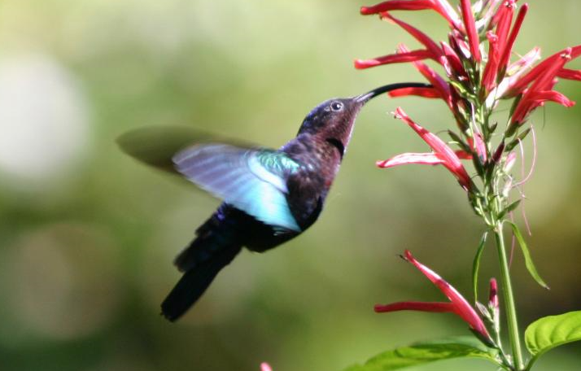
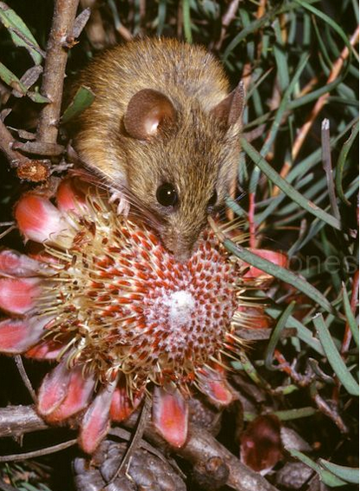
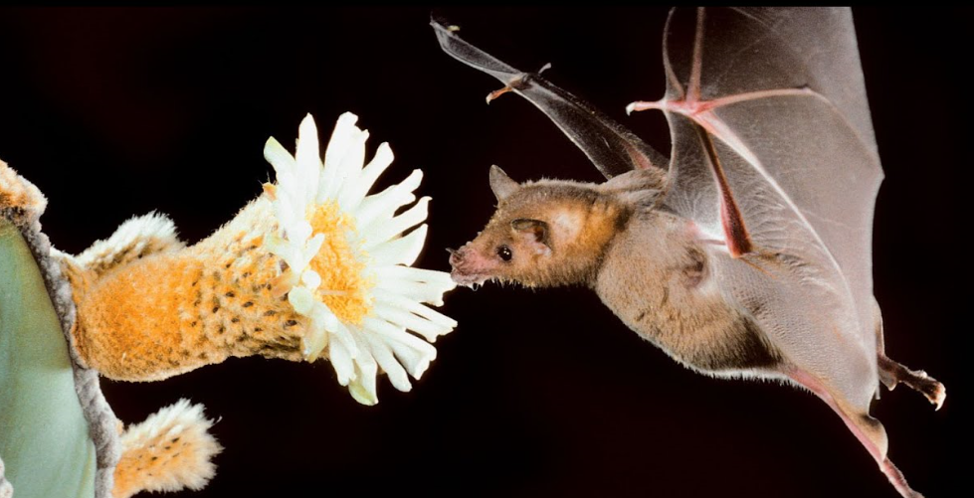
These are pollinators too!

Slide 7
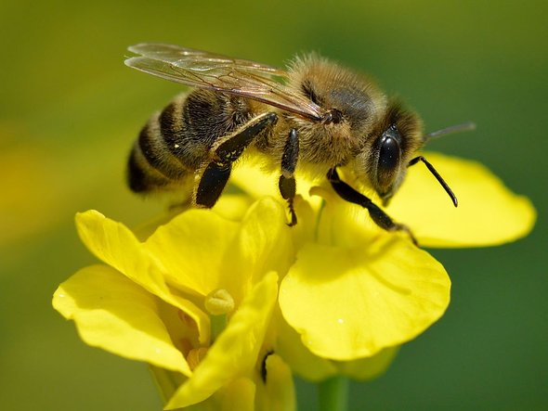
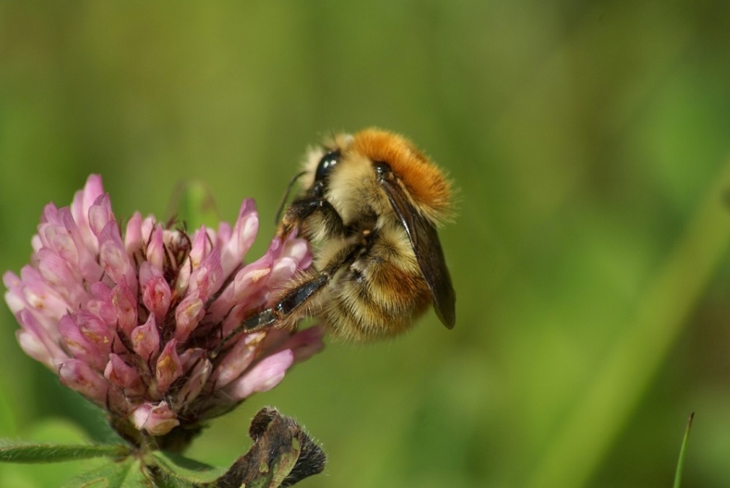
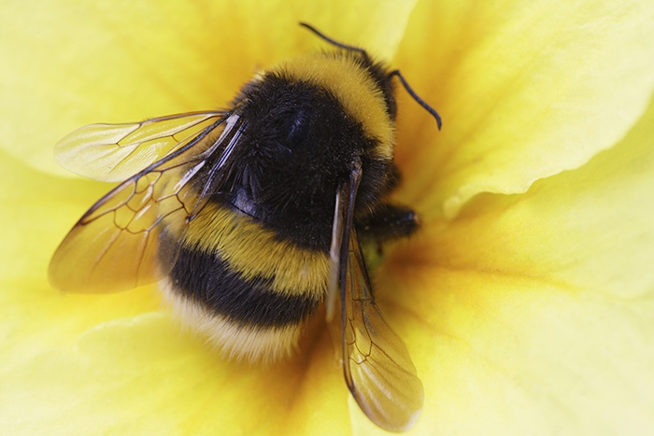
Bees!!
Honeybee (x 1 in Ireland, not in wild)
Solitary bees (x 77 in Ireland)
Live in holes in sloped soil banks
Bumblebee(x 20 in Ireland). Live in hives. Numbers decreasing.
Notes:
Most pollinators in Ireland are bees
Also hoverflies, wasps, butterflies and birds.
98 bee species in Ireland: 1 honeybee in domesticated hives, 20 bumblebee species and 77 solitary bees that live on their own in burrows in slopes of soil.
Bumblebees and solitary bees are wild pollinators. Honey bees are mostly in hives in Ireland so are not wild.

Slide 8
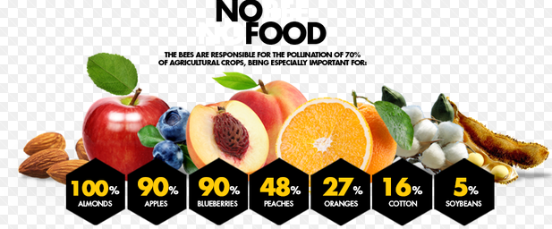
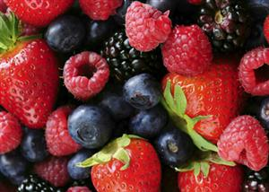
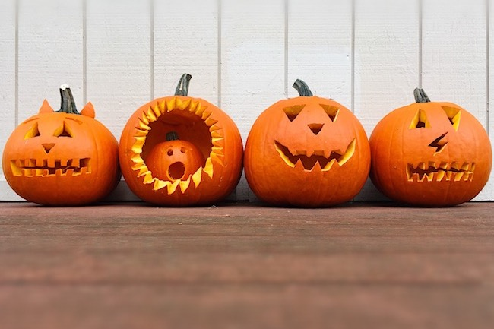
So what?
Pollinators needed for these.
Notes:
Pollinators are necessary for lots of food we like to eat, pumpkins to eat and carve and natural materials for clothing.
As pollinators decline so do our food choices and food becomes more expensive to buy.

Slide 9
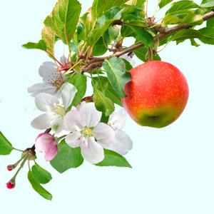
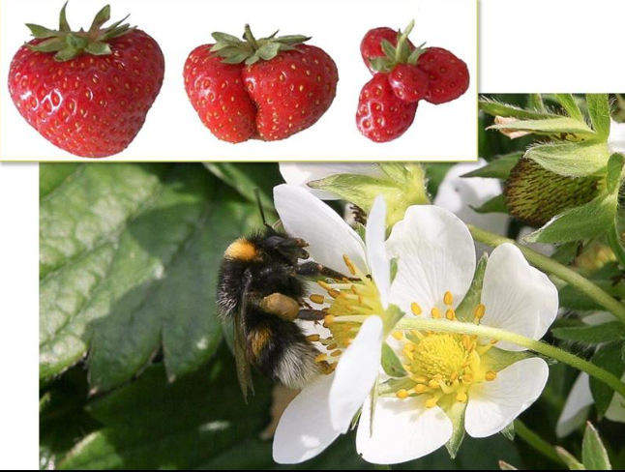
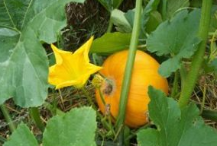
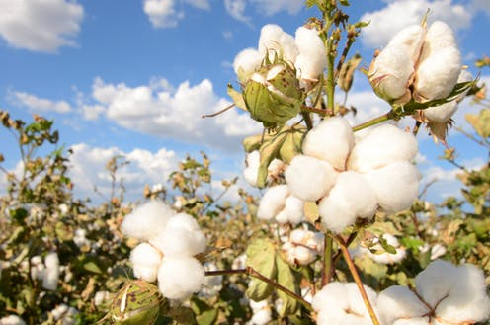
From flowers come fruit....
Strawberry
Apple
Cotton
Pumpkin
Notes:
Bottom rhs is cotton plant

Slide 10
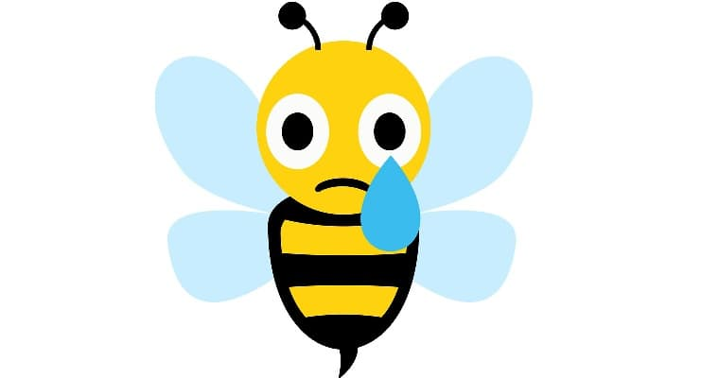
Where are all our bees gone?

Slide 11
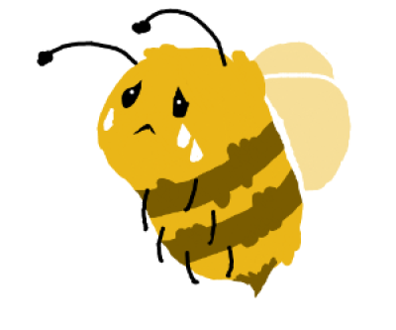
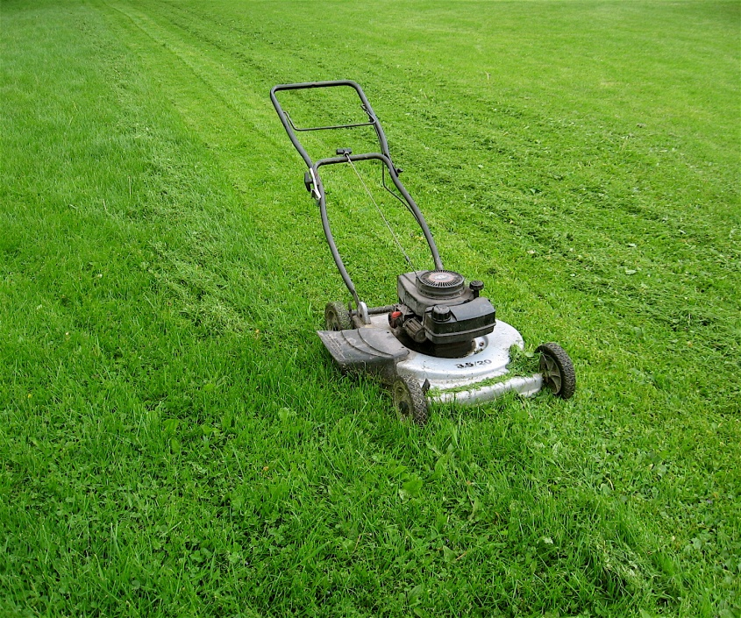
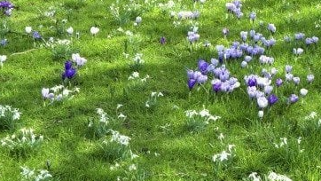
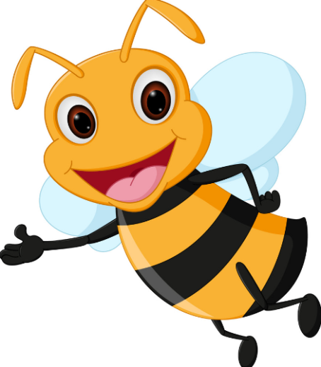
We’re too tidy. Need to leave some long grass.
Crocus and snowdrop excellent as early food source for bees emerging from hibernation in February.
Notes:
Queen bumblebees hibernate in burrows in ground in long grass.
Cutting grass short exposes their burrows.
Cutting grass also gets rid of food sources such as clover, dandelions.

Slide 12
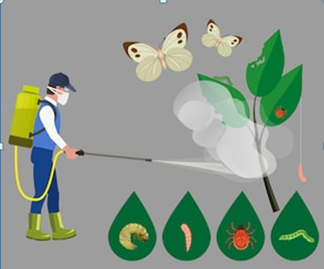
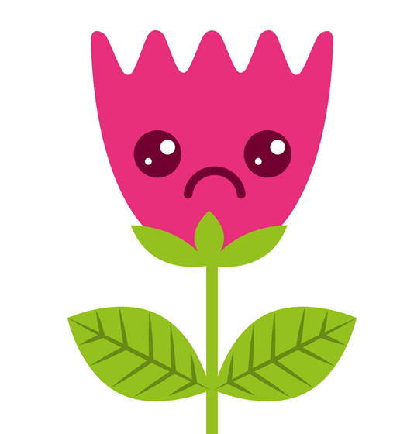
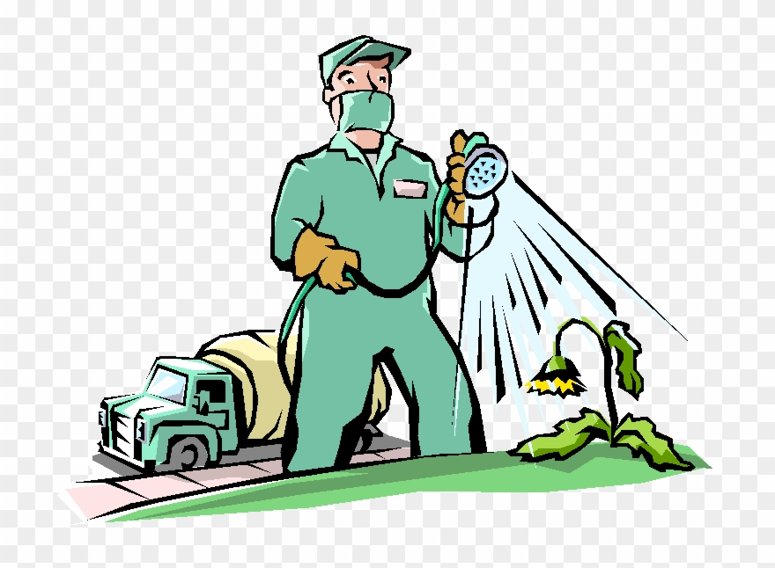
Pesticides and Weedkillers
We’re spraying everything.
Notes:
Pesticides kill bees.
Weedkillers kill their food plants e.g dandelions, clover

Slide 13
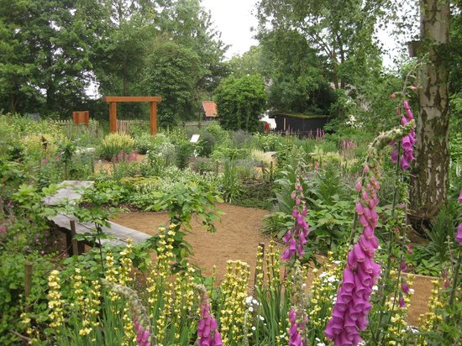
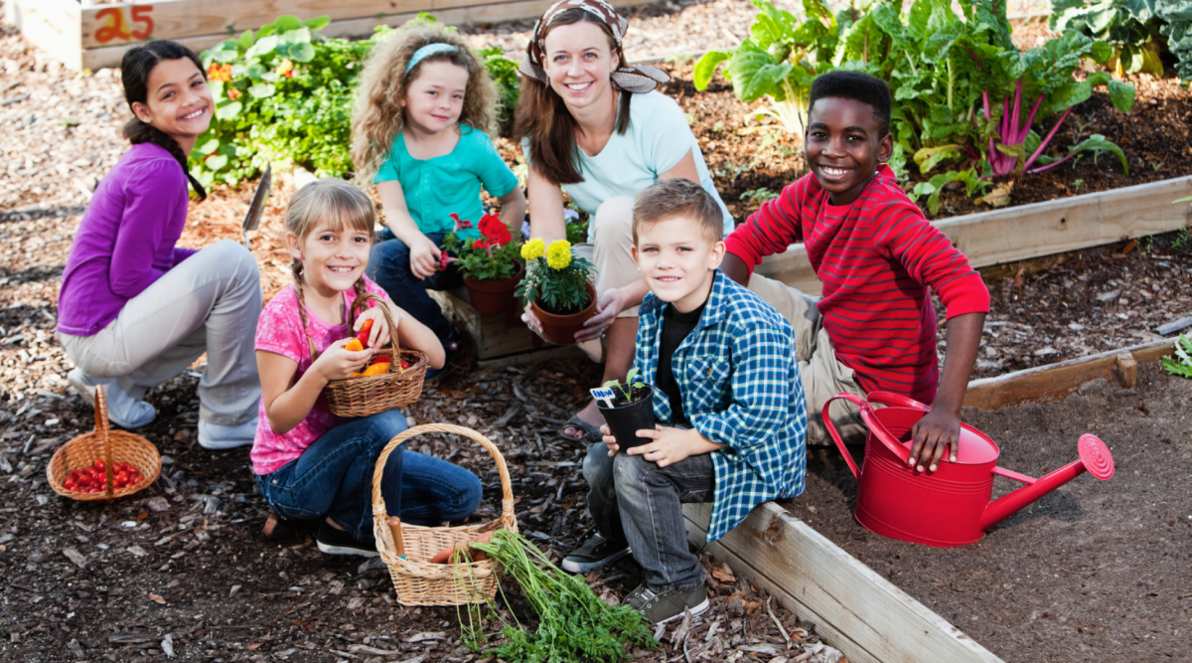
What can we do???
Grow flowers!
Notes:
What can we do to conserve our pollinators?
Grow pollinator friendly flowers throughout months of February-October

Slide 14
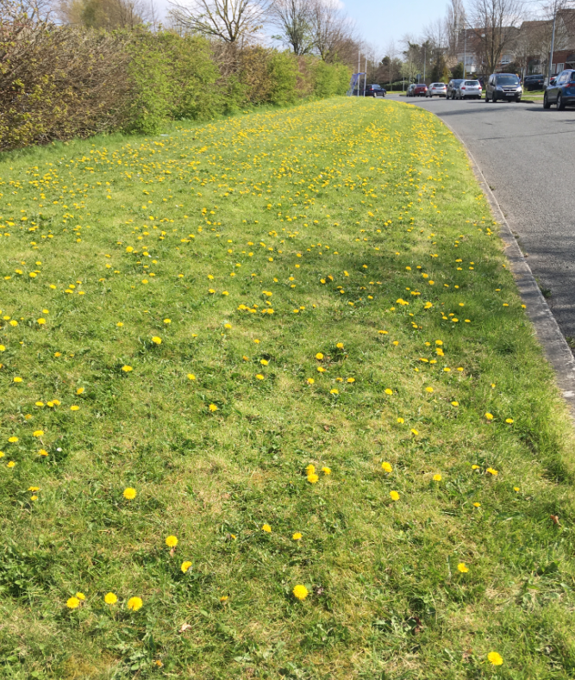
Luttrellstown Ave.
Let the dandelions bloom!
Dandelions and clover some of best food for bees and pollinators.
Notes:
Fingal County Council leaves areas of grass to grow and lets dandelions grow too.

Slide 15
Why we designed the garden the way it is:
Insect hotel
Rocks
Logpile
Sloped soil
Pollinator-friendly flowers
...................................read on............

Slide 16
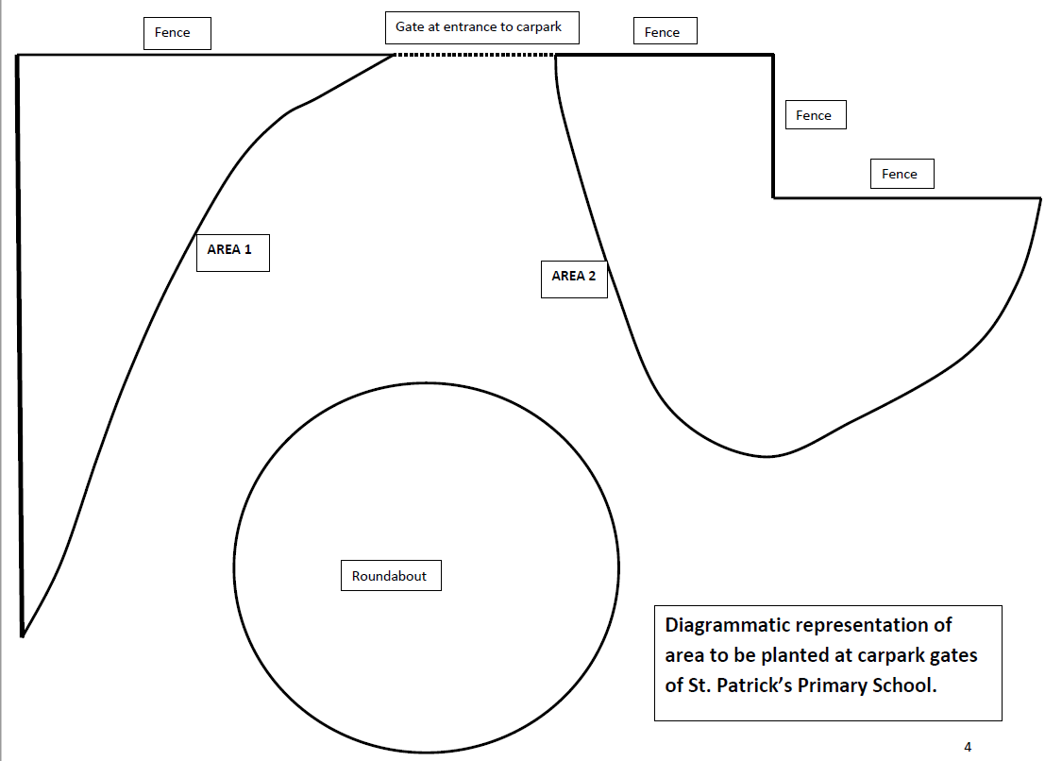
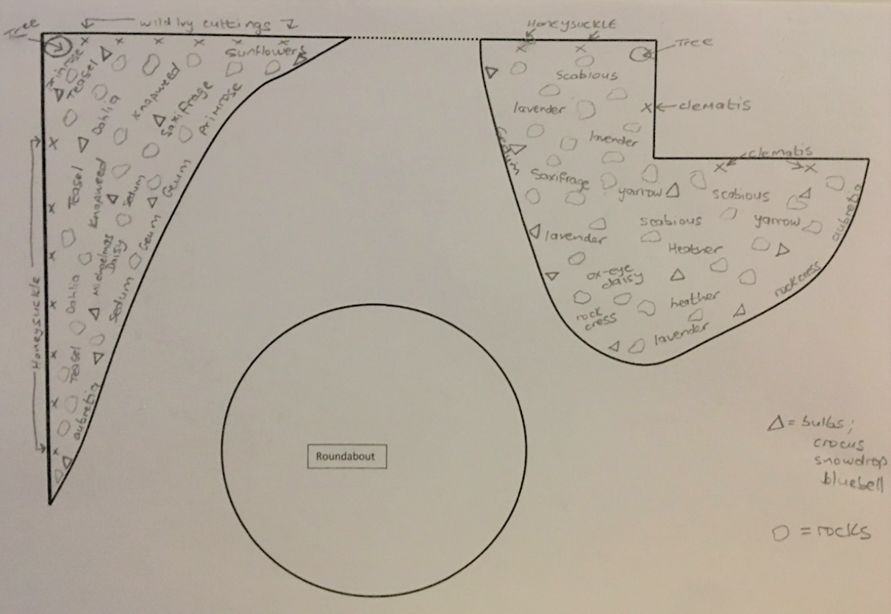
First draft Plan drawings

Slide 17
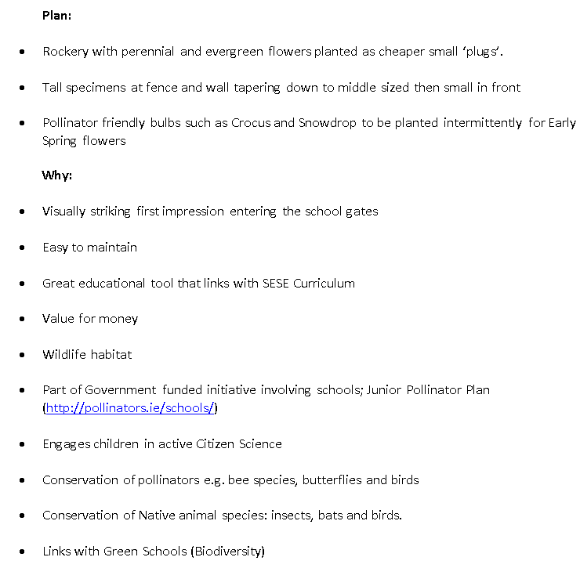
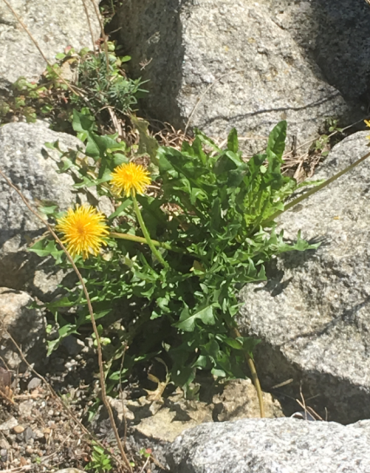
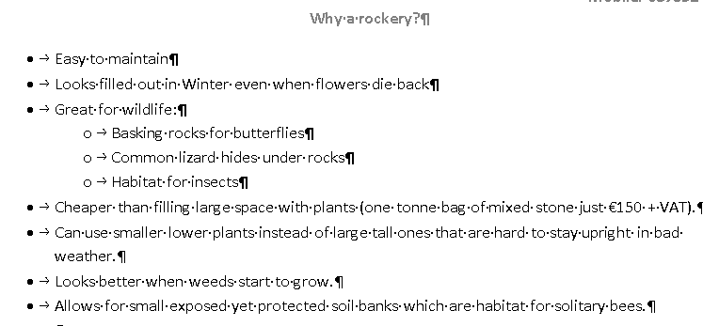
Dandelions look great in rockeries!
Plan presented to the school

Slide 18
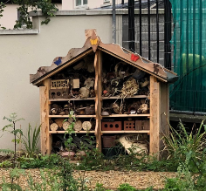
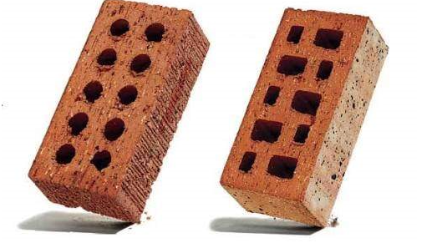
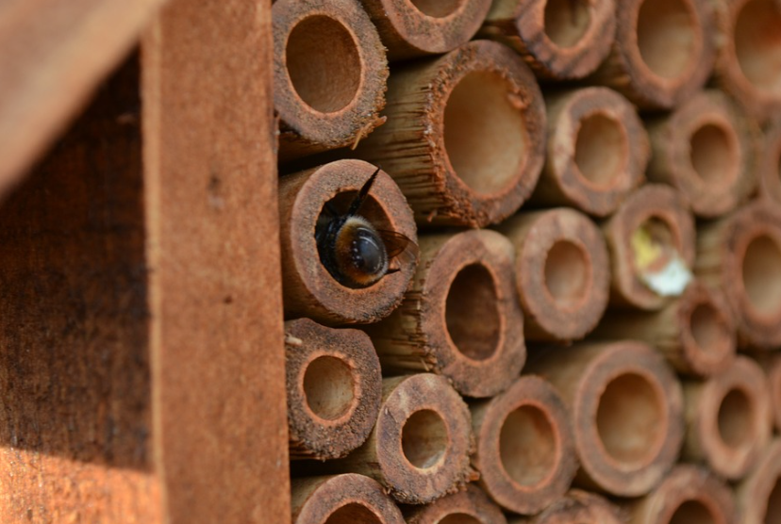
Insect hotel:
Provides shelter in winter & is hibernation site for insects. Straw, hollow stems, hollow bricks, flower pots, sticks, wooden logs with drilled holes; all provide snug spaces
Bugington Palace!
Solitary bee in bamboo stem
Notes:
Hollow spaces for insects like bees and butterflies to hibernate in winter.
Insect hotels are filled with straw, hollow bricks, hollow bamboo etc. In which insects can hibernate and take shelter.
Bricks with holes are good hibernation shelters as are hollow bamboo stems.

Slide 19
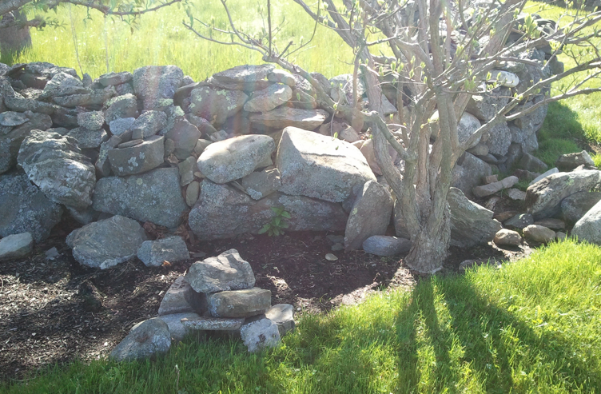
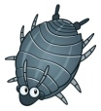
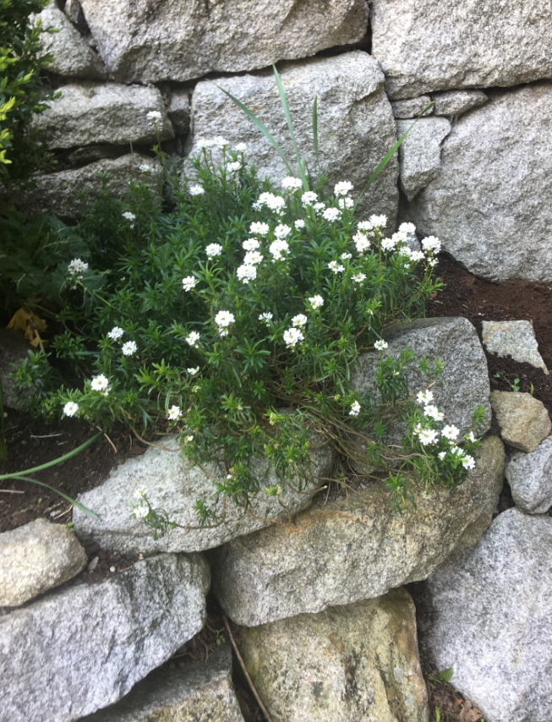
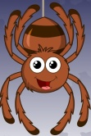
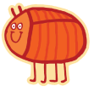
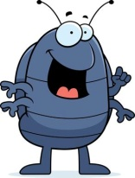
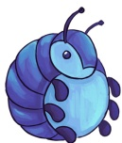
Insects love rocks!
Frogs and Common lizard also hibernate under rockpiles.

Slide 20
Bare soil slopes for solitary bees
Rocks for winter hibernation shelters and for basking butterflies in summer
Most of Irish bees are solitary; live in holes in sloped soil.
Notes:
Provide bare soil slopes for solitary bee burrows

Slide 21
Logpile: great for hedgehogs, frogs, common lizard and insects

Slide 22
St. Patrick’s N.S.
1st there was nothing!
Notes:
Bare soil outside carpark gates

Slide 23
Weeding!
Notes:
Weeding!

Slide 24
More weeding and digging!

Slide 25
Rocks arrived

Slide 26
Getting supplies!
Notes:
Getting supplies!

Slide 27
Logs for logpile!
Notes:
Mr. Thynne’s Class built the logpile

Slide 28
Trees planted, bug bricks put in place

Slide 29
First plants planted and pathway created!

Slide 30
Our new insect house and Tom the builder from Mulhuddhart Men’s Shed!
Brendan, School caretaker made path
Children brought in and made insect hibernation habitats in the hotel
Notes:
We got the Men’s Shed in Mulhuddhart to make our insect hotel. Children brought in things to fill it like bamboo stems, pine cones, straw, tubes, blocks etc.

Slide 31
Free Stuff!!
Tiles, pipes and blocks for insects and wildlife like hedgehogs
Gutter pipes as wildlife refuges and shelter

Slide 32
Lots of watering and care
Extra large watering can!!
Grass clump removal!

Slide 33
And now just 4 months on......

Slide 34
Wildflower area sown with native Irish wildflower seed....15 species in just 3 months.....
Willowherb
Black medick
Chamomile
Scarlet pimpernel
Cornflower
Common fumitory

Slide 35
Success!!

Slide 36
Wildflower area looked neglected at start. A shape was created using spray paint. Plants pulled out of this outside border area. Planted with Spring pollinator friendly bulbs and daffodils.

Slide 37
Shape on wildflower area and walkway

Slide 38
Spring Bulbs along margins:

Slide 39
School competition for garden signs to inform public!
Notes:
Put up signs so parents and neighbours understand what we’re doing.

Slide 40
Signage: Educate, Sense of Ownership...

Slide 41
To do....
Keep it alive!
Increase our team of gardeners
Increase pollinator friendly spaces in the school
More education in the community

Slide 42
https://www.youtube.com/watch?time_continue=2&v=uBIKqFywxTY
Let’s all get involved!!
Notes:
Have fun!!
Pollinator video.
https://youtu.be/OJKGw6v8UZ8

