Slide 1
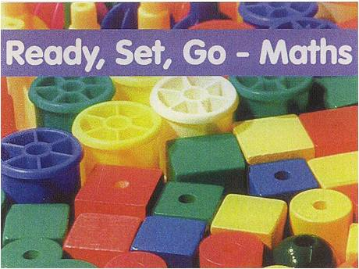
Ready, Set, Go- Maths
Eunice Pitt

Slide 2
Ready, Set, Go Maths
Part of the new Literacy and numeracy strategies encouraged by the DES.
An initiative which is funded for DEIS schools.
PA have funded the Materials for RSGM.

Slide 3

Ready, Set, Go Maths
Key message is to have children engaged in active learning.
Where possible two teachers are in the class working with smaller groups.
Children work at a ‘station’. Usually doing one activity per day. Five different activities per week.
The activities are generally working with concrete materials and playing games.
Focus is on discovery learning, and developing language for children to describe the process used.

Slide 4
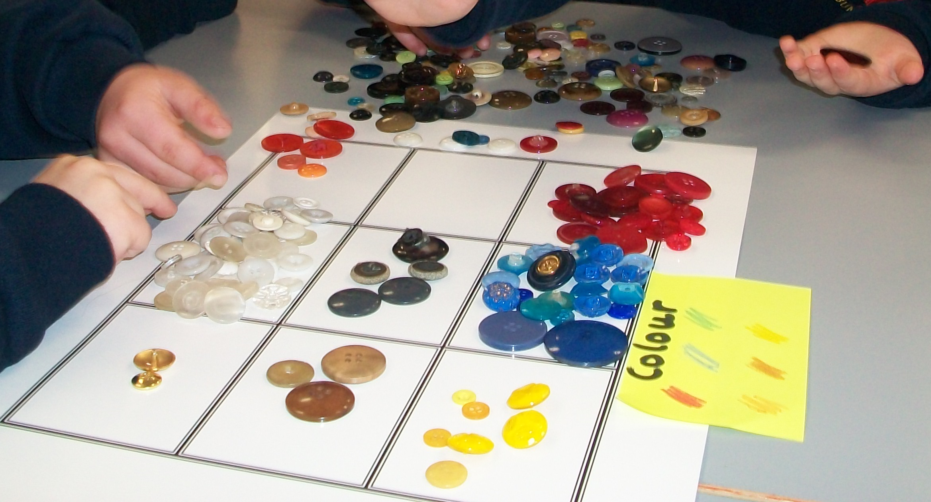
Sorting by colour

Slide 5
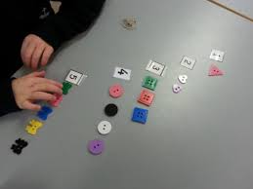
Matching numbers to objects

Slide 6
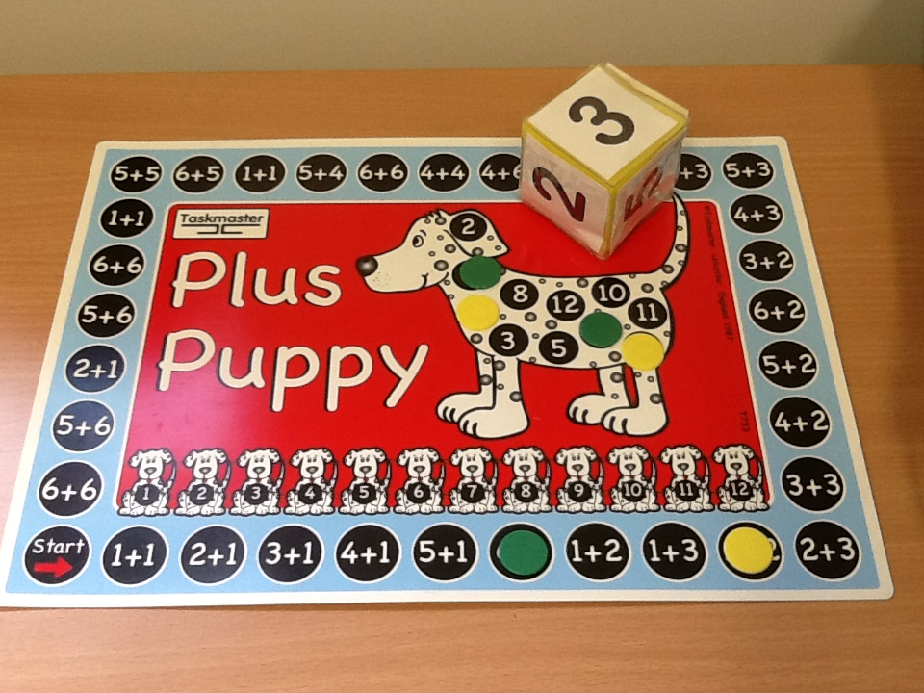
Dice games

Slide 7
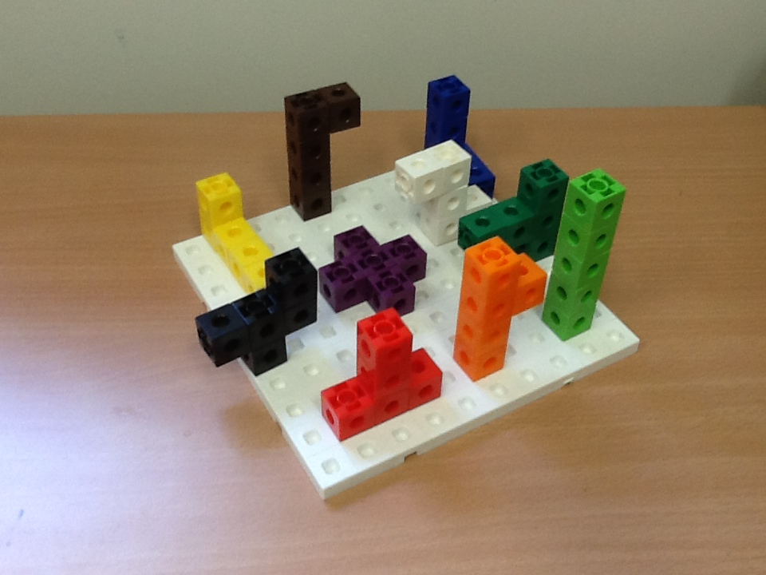
Making shapes from 5 interlocking cubes.

Slide 8
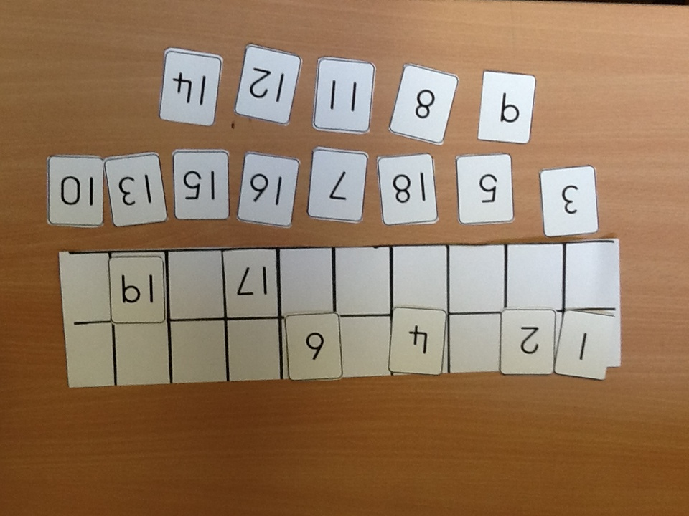
Ordering numbers in a 20 frame

Slide 9
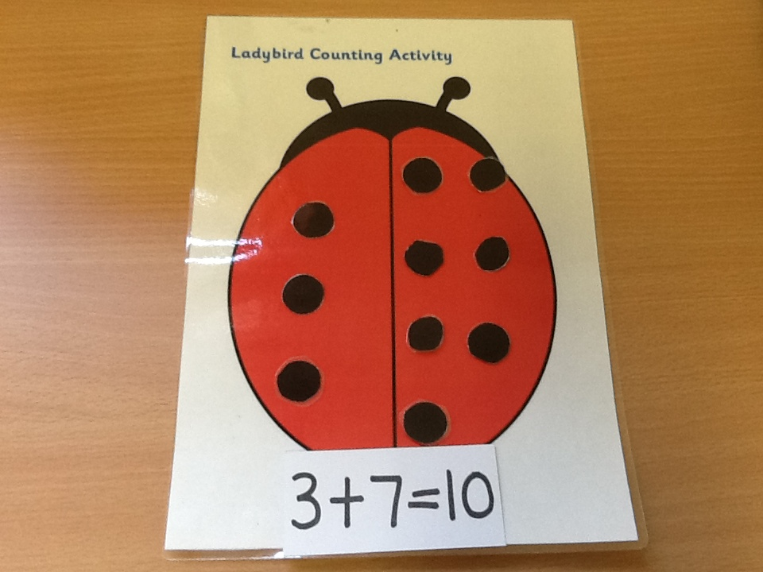
Making the story of 10

Slide 10
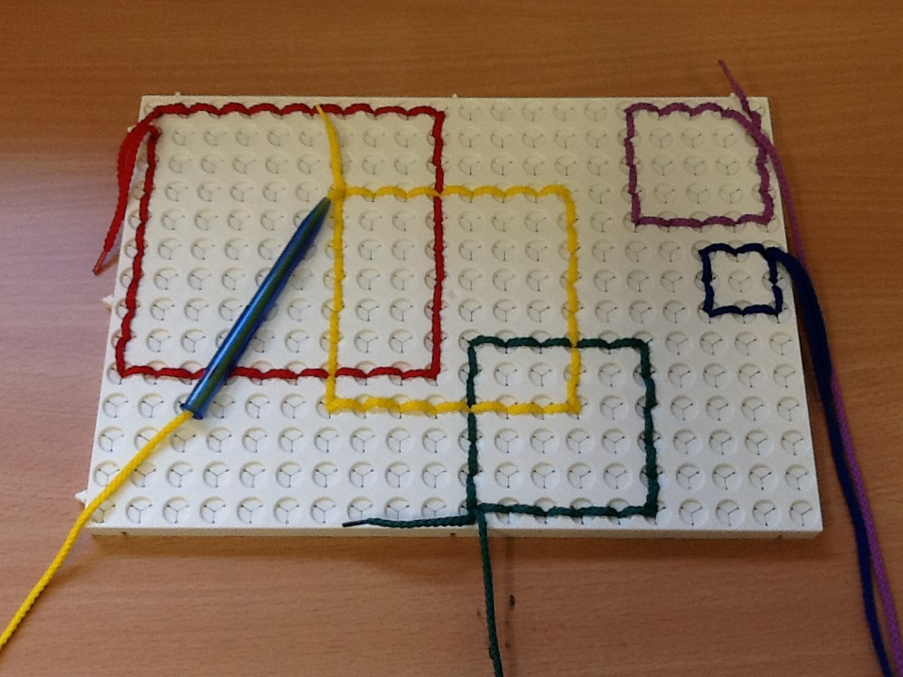
Making squares

Slide 11
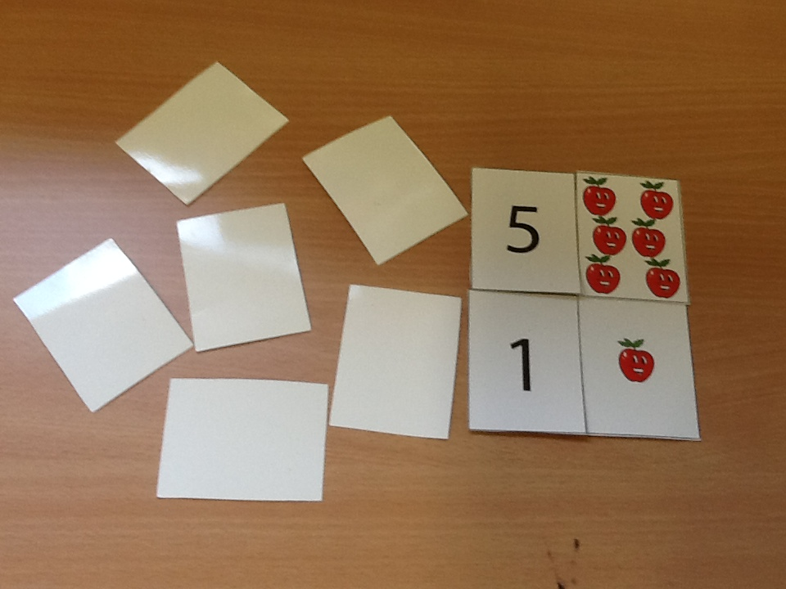
Go Fish!

Slide 12
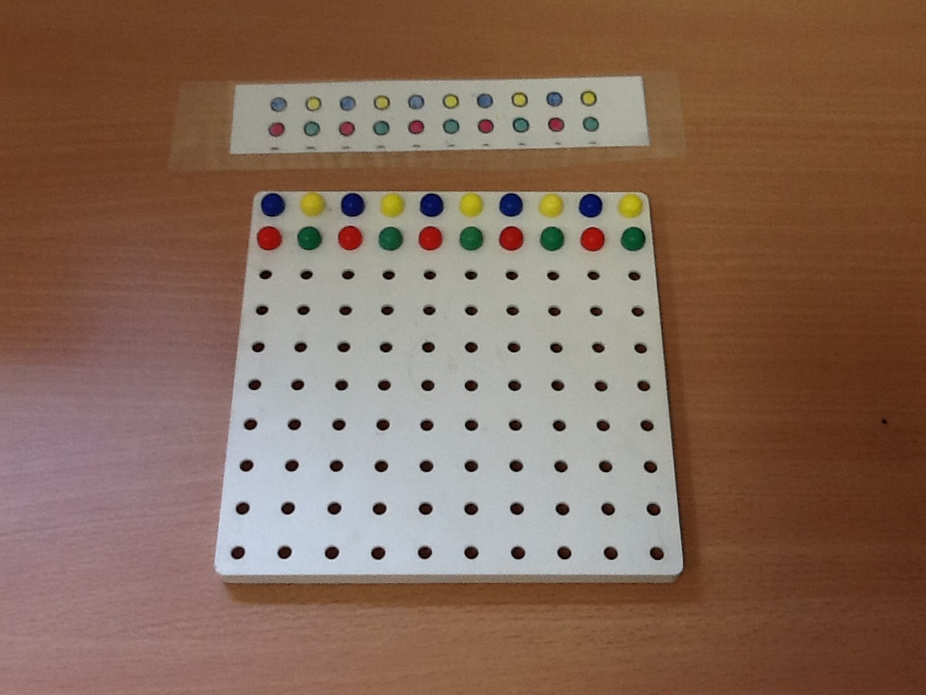
Copying a pattern

Slide 13
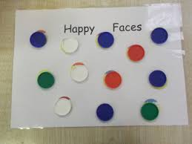
Happy Faces Dice Game
One to One Correspondence

Slide 14
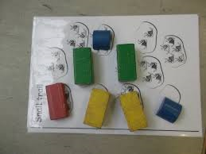
Snail Trail Number Dice Game

Slide 15
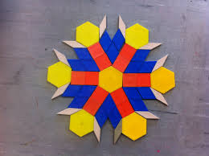
Fun with shapes

Slide 16

Maths Eyes

Slide 17

Maths Eyes
Looking for numbers all around us.

Slide 18
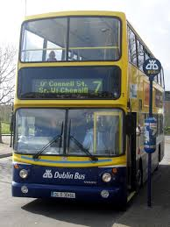
Numbers all around us

Slide 19
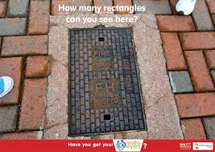
Looking for Shape in the environment

Slide 20
Useful links for parents
NCCA website has useful tips for parents on how to help your child with play, language development and maths.
There are clips on how to help your child in a number of languages
See school website for links to
Video clips on how to help your child

